Slide 1
Correlation

Slide 2
Linear Correlation
The topic of this lecture involves measuring the strength of the linear relationship between two random variables (each with at least an interval scale level of measurement).
Researchers often wish to determine whether or not two variables are related. For example, a researcher might be interested in knowing whether or not there is a relationship between how long people live (longevity) and the number of calories consumed per day. Or, between hours spent on the Internet and high school average; or hours spent studying and grades on a statistics final. These are situations where correlation might be appropriate.
In this course we will be looking at linear correlation.

Slide 3
Linear Correlation
We will use a simple formula to compute r, the correlation coefficient, from sample data. This correlation coefficient, r, ranges from -1 to +1.
An r of +1 indicates a perfect positive linear relationship.
An r of -1 indicates a perfect negative linear relationship.
An r of 0 indicates absolutely no linear relationship.
r, the sample correlation coefficient is an estimate of the population correlation coefficient, ρ (rho). We can compute ρ only if we take a census of the entire population.

Slide 4
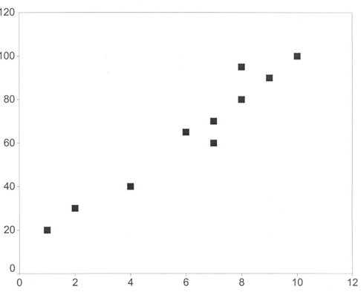
A Positive Relationship
A correlation of coefficient, r, of +1 indicates a perfect positive linear relationship between the two variables. In fact, if we draw a scatter plot placing all the paired sample data on a graph, all the points would lie on a straight line. Of course, in real life, one almost never encounters perfect relationships between variables. For instance, it is certainly true that there is a very strong positive relationship between hours studied and grades. However, there are other variables that affect grades as well. Two students can each spend 20 hours studying for an exam and one will get a 100 on the exam and the other will get an 80. This indicates that there is also random variation and/or other variables that explain performance on a test (e.g., IQ, previous knowledge, test taking ability, etc.).

Slide 5
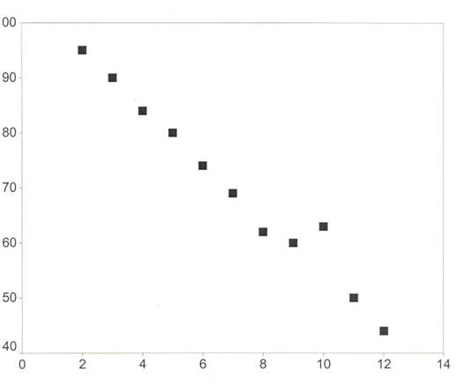
A Negative Relationship
A correlation of -1 indicates a perfect negative linear relationship (i.e., an inverse relationship). In fact, in a scatter plot, all the points would lie on a line with a downward slope.

Slide 6
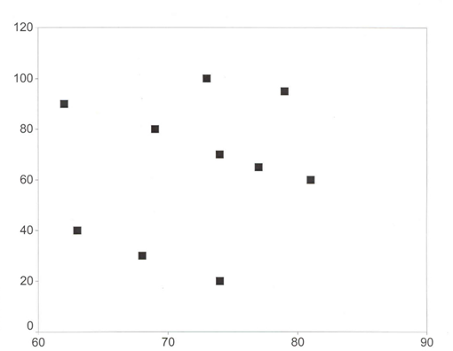
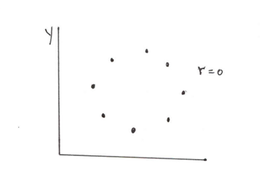
No Linear Correlation (r = 0)
A correlation of 0 indicates absolutely no relationship between X and Y. In real life, correlations of 0 are very rare. You might, rather, get a correlation of .10 and it will not be significant, i.e., it is not statistically different from 0. (There are ways to test correlations for significance.)
no relationship at all
no linear relationship

Slide 7
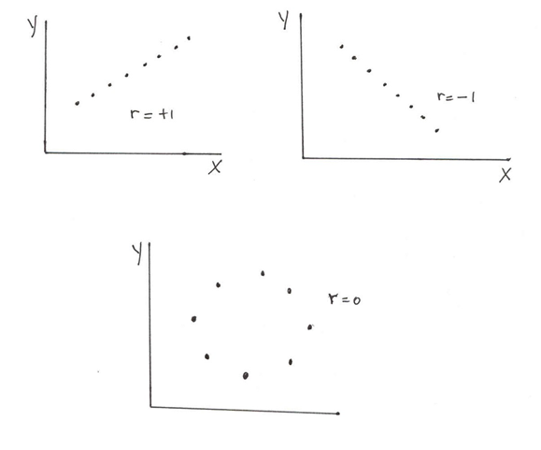
Three Extreme Situations: r = +1, r = -1, and r = 0

Slide 8
Correlation and Causality
Correlation does NOT imply causality. Here are four possible explanations for a significant correlation:
X causes Y
Y causes X
Z causes both X and Y
Spurious correlation (a fluke)
Examples:
Poverty and crime are correlated. Which is the cause?
3 % of older singles suffer from chronic depression; does being single cause depression? Perhaps, being depressed results in one being single. People do not want to marry unhappy people.
Cities with more cops also have more murders. Does ‘more cops’ cause ‘more murders’? If so, get rid of the cops!
There is a strong inverse correlation between the amount of clothing people wear and the weather; people wear more clothing when the temperature is low and less clothing when it is high. Therefore, a good way to make the temperature go up during a winter cold spell is for everyone to wear very little clothing and go outside.
There is a strong correlation between the number of umbrellas people are carrying and the amount of rain. Thus, the way to make it rain is for all of us to go outside carrying umbrellas!

Slide 9
Coefficient of Determination, R²
The coefficient of determination, R² (in Excel, it is called R-squared) is also an important measure. It ranges from 0 to 1.0 (or, 0% to 100%) and measures the proportion of the variation in Y explained by X. R² is actually equal to (r)², or in other words, the square of the correlation coefficient.
When you do correlation, you generally do not worry about which is the X and which is the Y variable since you have no interest in predicting Y from X. In regression, where you want to see an equation relating X to Y, you must specify which is the Y-variable (dependent variable) and which is the X-variable (independent variable). The correlation coefficient is the same regardless of which variable is X and which one is Y. The regression equation will be different if you reverse the X and Y.

Slide 10
Coefficient of Determination, R²
If all the points are on the line, r = 1 (or -1 if there is an inverse relationship), then R² is 100%. This means that all of the variation in Y is explained by (variations in) X. This indicates that X does a perfect job in explaining Y and there is no unexplained variation.
Thus, if r = .30 (or -.30), then R² = .09. Only 9% of the variation in Y is explained by X and 91% is unexplained. This is why a correlation coefficient of .30 is considered weak—even if it is significant.
If r = .50 (or -.50), then R² = .25. 25% of the variation in Y is explained by X and 75% is unexplained. This is why a correlation coefficient of .50 is considered moderate.
If r = .90 (or -.90), then R² = .81. 81% of the variation in Y is explained by X and 19% is unexplained. This is why a correlation coefficient of .90 is considered very strong.

Slide 11
Computing the Correlation Coefficient
The input data consists of pairs of numbers, X_{i} and Y_{i}. It does not matter which variable you call X and which variable you call Y when you are doing correlation. (That will become important when we study regression.)
To compute r, you need n (number of pairs of observations) and the following summations:
∑X_{i}, ∑Y_{i}, ∑ X_{i}Y_{i}, ∑X_{i}², and ∑Y_{i}²
This is very easy to compute in a spreadsheet. For simplicity, we have removed the subscripts. Note that ∑X_{i}² is not equal to (∑X_{i})²

Slide 12
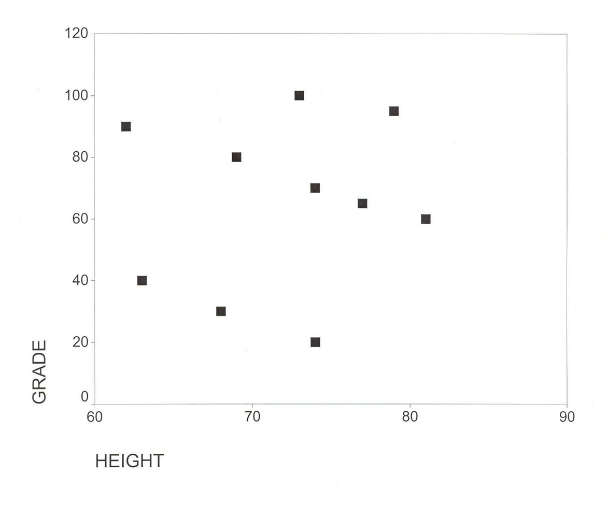
Example 1: Grade and Height
Y (Grade) | 100 | 95 | 90 | 80 | 70 | 65 | 60 | 40 | 30 | 20
X (Height) | 73 | 79 | 62 | 69 | 74 | 77 | 81 | 63 | 68 | 74
∑X_{i} = 720
∑Y_{i} = 650
∑X_{i}Y_{i} = 46,990
∑X_{i}² = 52,210
∑Y_{i}² = 49,150

Slide 13
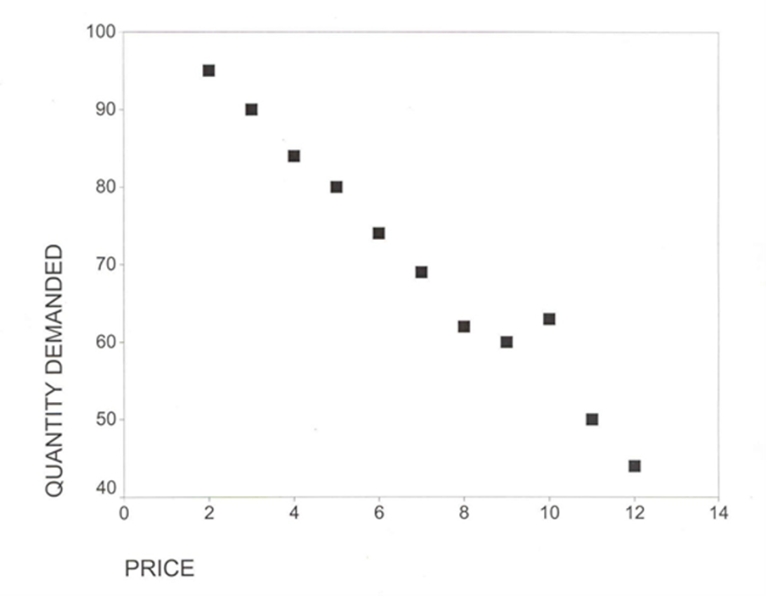

Example : Price and Quantity
∑X_{i}=77
∑Y_{i}=771
∑X_{i}Y_{i}=4,867
∑X_{i}² =649
∑Yi² =56,667

Slide 14
Example : Price and Quantity (cont’d)
r = =
r = -.99; R² = 98.01%
To test the significance of the correlation coefficient, a t-test can be done. The correlation coefficient is significant (again, you have to trust me on this). A correlation coefficient of -.99 is almost perfect. Thus, there is a significant and strong inverse relationship between price and quantity demanded.

